Slide 1

Laptop Pricing & Market Trend Analysis
Presented By:
B Vijaya Lakshmi
Batch No: 460

Slide 2
About me
I am a Recent Post Graduate in Data Science from Bankatlal Badruka College For Information Technology
As a Data Science graduate, I am passionate about applying analytical and technical skills to solve real-world business problems using data-driven approaches.
LinkedIn : www.linkedin.com/in/bollapalli-vijaya-lakshmi
GitHub : Vijayalakshmibollapalli

Slide 3
Agenda
Business Problem and Objective
Web Scraping
Dataset Overview
Data Cleaning
Univariate Analysis
Bivariate Analysis
Multivariate Analysis
Hypothesis Testing
Challenges Faced
Final business insights and recommendations
Conclusion

Slide 4
Business Problem
Laptop prices vary widely across different brands and specifications in the market. Features such as RAM, processor, storage, and brand reputation can significantly affect the price of a laptop.
Because of these variations, it becomes difficult for customers to easily compare laptops and understand whether a laptop is reasonably priced.
Although many laptops are listed on online platforms, the data is not structured in a way that makes it easy to analyze pricing patterns and feature differences.
Therefore, this project focuses on collecting and analyzing laptop data to identify the key factors that influence laptop prices.

Slide 5
Objective
To collect laptop data from online platforms
To clean and organize the data for analysis.
To analyze how features like brand, processor, RAM, storage, and rating affect laptop prices.
To identify the key factors influencing laptop pricing.
To understand pricing trends in the laptop market and provide useful insights for better purchasing decisions.
To provide data-driven insights for better purchasing decisions.

Slide 6
Web Scraping Details
Website: Online Shopping Site for Mobiles, Electronics, Furniture, Grocery, Lifestyle, Books & More. Best Offers!
Tools Used: Python, Selenium, Locators (XPath / CSS Selectors), and Regular Expressions (Regex) were used to automatically open the website and extract laptop information.
Approach: Inspecting The Website > Install Selenium > Opens Target URL > Locate Elements(XPath/CSS) > Extract The Data Using Regex > Create Pandas DataFrame > Store The Data.
Saved To Structured Data Frame For EDA Analysis

Slide 7
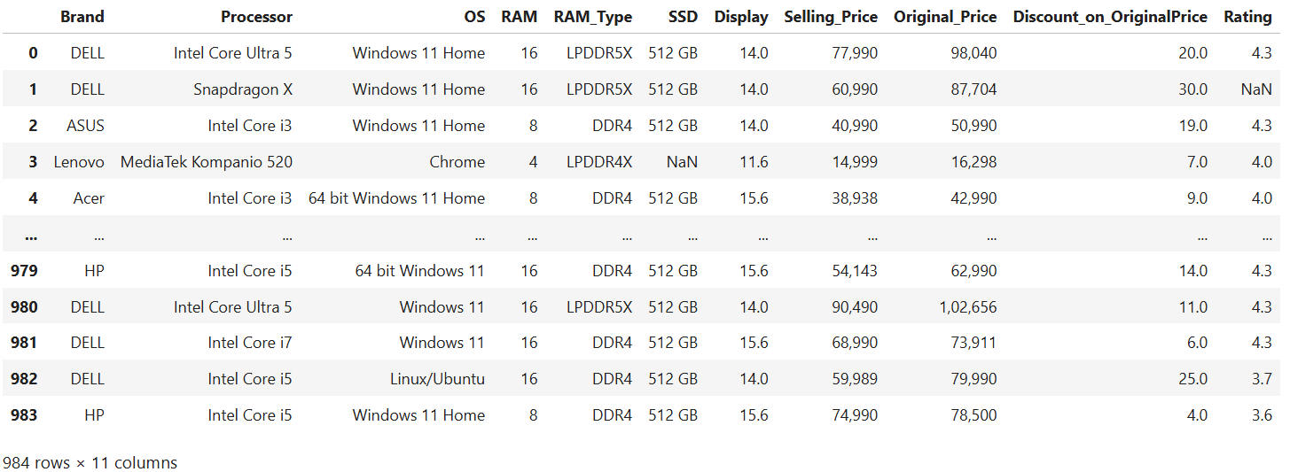
Summary Of The Data
Total Laptop Variants Extracted: 984
11 Colums: Brand, Processor, Operating System, RAM, RAM_Type, Storage (SSD), Display, Selling_Price, Original_Price, Discount_on_OriginalPrice, Rating

Slide 8
Data Cleaning
Removed unwanted text and symbols from different columns to keep only useful values.
Converted columns to appropriate data types such as integer and float for proper analysis.
Extracted numerical values from text fields such as SSD using Regular Expressions (Regex).
Removed duplicate records to maintain data accuracy.
Handled missing values using appropriate techniques to ensure dataset completeness.
This cleaning process improved the quality, consistency, and reliability of the dataset, making it ready for EDA and visualization.

Slide 9
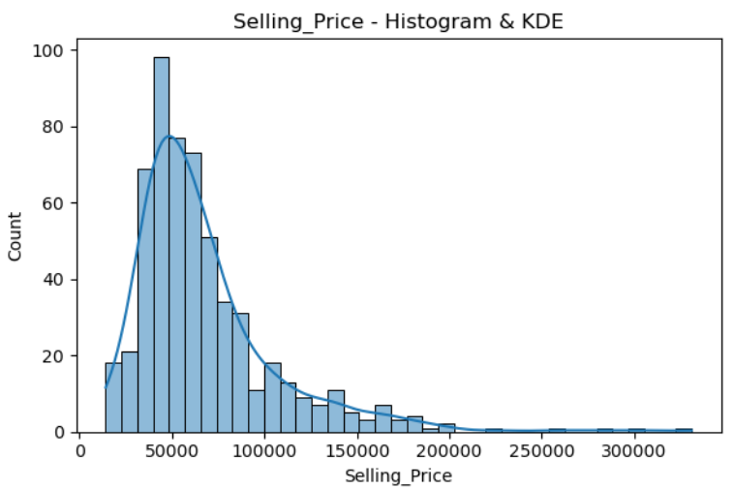
Selling Price Distribution
Univariate Analysis
Insight
The Selling Price distribution is right-skewed, indicating most laptops fall in lower and mid-price ranges.
The majority of laptops are concentrated around ₹40,000 – ₹80,000, showing strong demand for mid-range models.
A few premium laptops create the right-side tail in the distribution.
Peaks in the curve represent price ranges where laptops are most commonly available in the market.

Slide 10
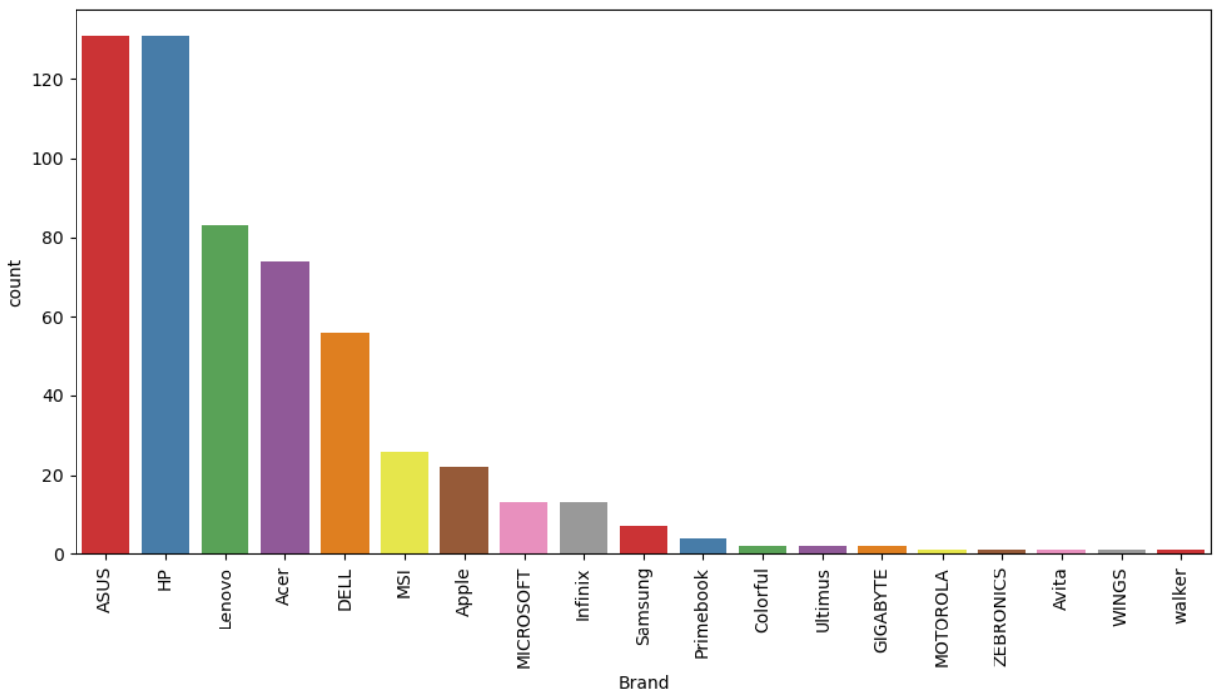
Brand Distribution
Insight
ASUS and HP dominate the dataset, having the highest number of laptop models.
Brands like MSI and Apple appear moderately, mainly representing premium or gaming laptops.
Some brands such as Motorola, Zebronics, Avita, Wings, and Walker have very few models, indicating limited market presence.

Slide 11
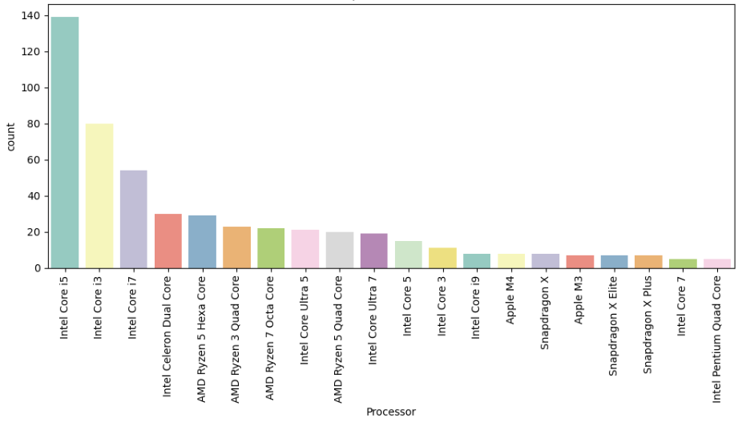
Processor
Insight
Most laptops are powered by Intel processors, especially Intel i5 and Intel i7, indicating strong market demand for balanced performance.
AMD Ryzen processors appear in several models and are commonly used in performance and gaming laptops.
High-performance processors are fewer in number because they usually belong to premium laptop segments.

Slide 12
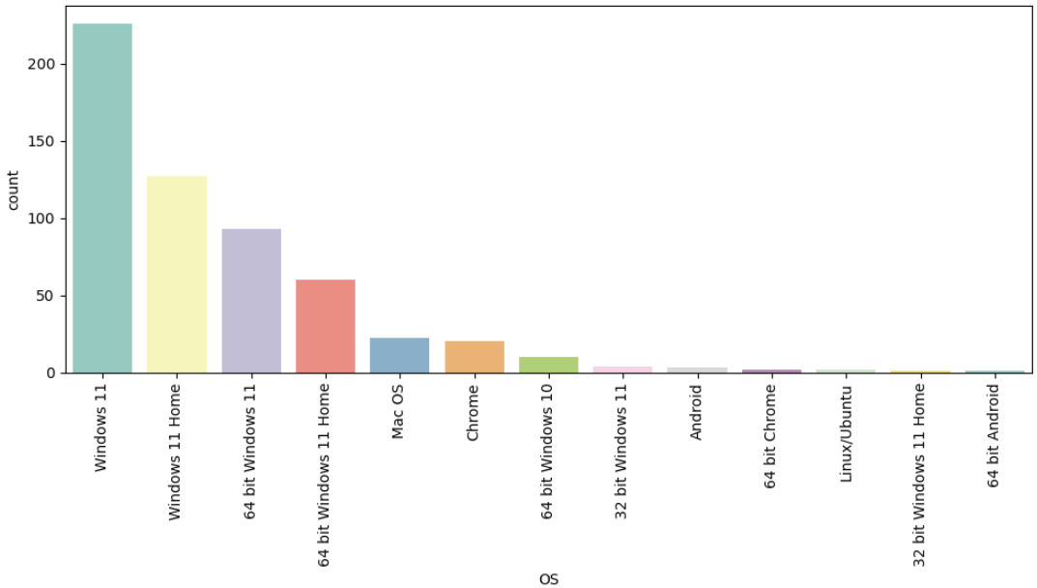
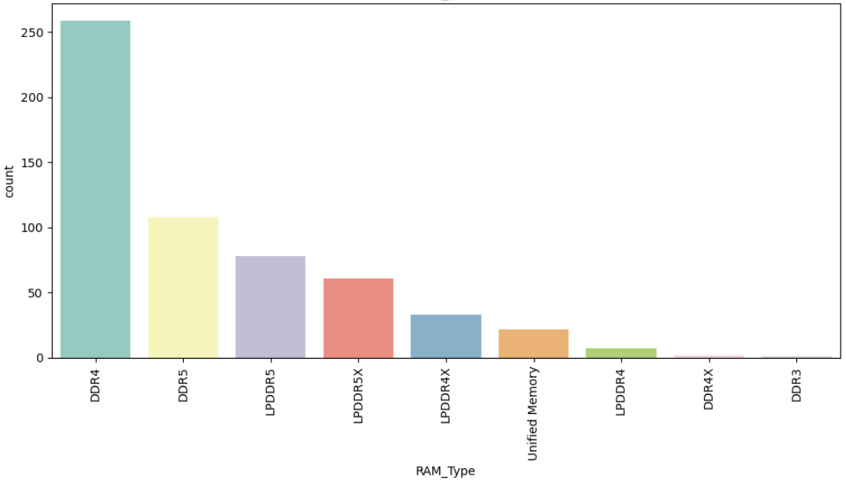
RAM Type Distribution
Operating System Distribution
Insight
The market is largely dominated by Windows operating systems, showing strong preference due to wide software compatibility and user familiarity, while macOS appears in fewer models as it is limited to Apple laptops.
Insight
Most laptops use DDR4 RAM, highlighting its balance between performance and cost efficiency, while DDR5 RAM appears in fewer models as it is mainly used in newer high-performance laptops.

Slide 13
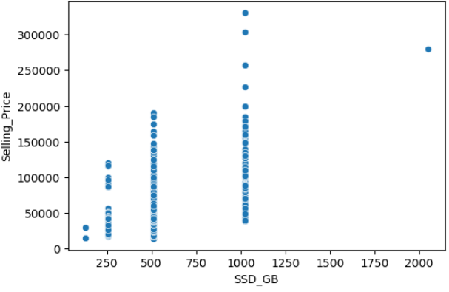
SSD Storage and Price
Bivariate Analysis
Insight
As SSD storage capacity increases, the laptop price generally increases, showing a positive relationship between storage size and price.
Most laptops are clustered around 512GB and 1TB, suggesting these are the most common configurations.
Laptops with 2TB storage are usually more expensive and premium models.

Slide 14
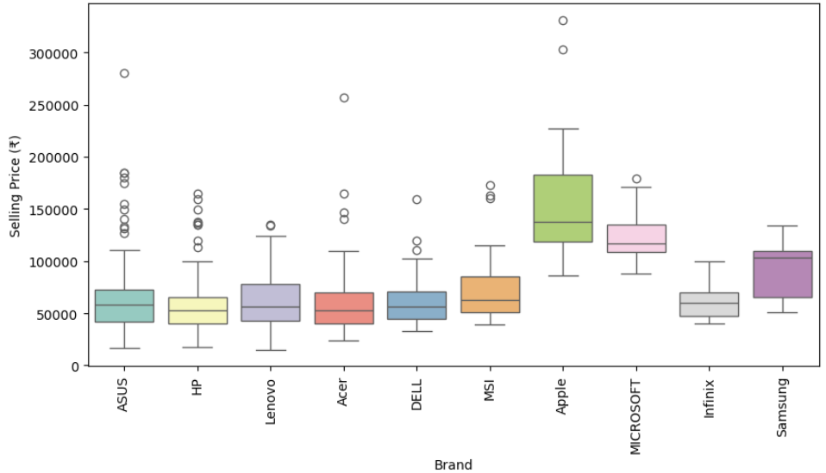
Brand and Price
Insight
Premium brands like Apple and Microsoft generally have higher median prices compared to other brands.
Brands such as ASUS, HP, Lenovo, Acer, and Dell show moderate price ranges with many variations, indicating availability of both budget and high-end models.
A few very high prices appear as outliers, which are usually premium or gaming laptops.

Slide 15
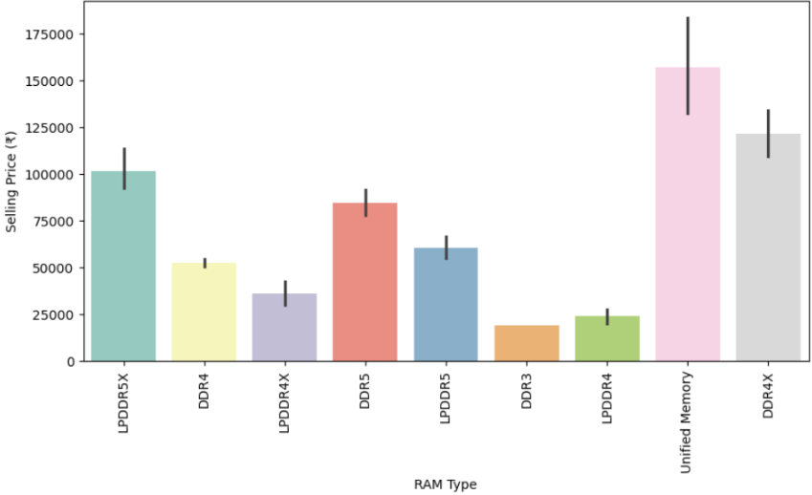
RAM Type and Price
Insight
Laptops with Unified Memory tend to have the highest average prices, commonly seen in premium devices such as those from Apple.
Newer RAM technologies like DDR5 and LPDDR5X are associated with higher price ranges, indicating more modern and powerful systems.
Older RAM types like DDR3 and LPDDR4 generally appear in lower-priced laptops, reflecting older hardware or budget devices.

Slide 16
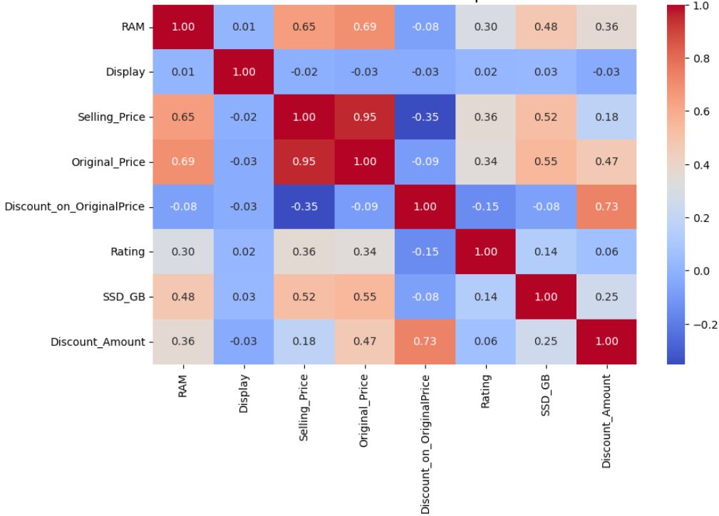
Correalation Heat Map
Multivariate Analysis
Insight
Price vs Other Features: Price shows strong positive correlation with Original Price, RAM, and SSD, meaning better specifications increase the selling price. It has weak correlation with Display and Rating, indicating these features have little influence on pricing.
RAM vs Storage: RAM and SSD storage show a moderate positive correlation (~0.48). This suggests laptops with higher RAM generally come with larger SSD storage capacity.
Discount vs Price: Discount on Original Price has a negative correlation with Selling Price (-0.35). This means higher discount percentages usually lead to lower final selling prices.
Original Price vs Discount Amount: There is a strong positive relationship (~0.73) between discount percentage and discount amount. Higher-priced laptops tend to have larger discount amounts when discounts are applied.
Overall Insight:
Laptop price is mainly influenced by hardware specifications like RAM and SSD along with the original price.
Features like display size and rating have minimal impact on pricing.

Slide 17
Hypothesis Testing
Hypothesis is a tentative assumption or statement about a relationship between variables that can be tested using data.
It is used in statistics to determine whether the observed pattern in data is real or occurred by chance.
Why Hypothesis Comes After Visualization?
Data visualization helps us identify patterns, trends, and possible relationships in the dataset through graphs and charts. It gives an initial idea of what appears to be happening in the data.
Hypothesis testing is performed after visualization to statistically verify whether these observed patterns are actually significant. It helps confirm that the results are real and not caused by random chance, making the analysis more reliable.

Slide 18
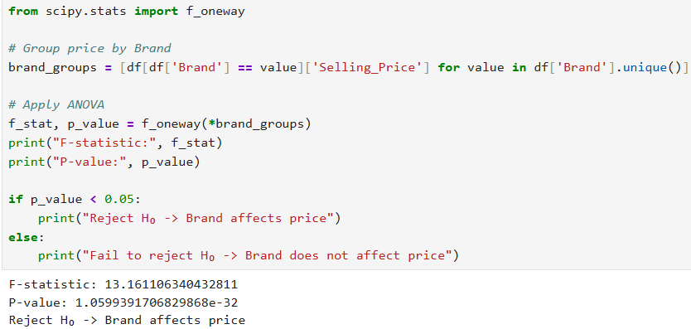
Hypothesis 1: Does Brand influence Laptop Price?
H₀(Null Hypothesis): Brand has no impact on laptop price.
H₁(Alternative Hypothesis): Brand affects price.
Test Used: ANOVA
Decision Rule :
If p < 0.05 → Reject H₀
If p ≥ 0.05 → Fail to reject H₀
Result :
F-statistic: 13.161106340432811
P-value: 1.0599391706829868e-32
Since p < 0.05 → Reject H₀

Slide 19

Insight:
Laptop prices vary across brands.
Apple and Microsoft laptops have higher median prices, while brands like HP, Acer, and Infinix generally have lower price ranges.
This shows that brand reputation and product positioning influence laptop pricing.

Slide 20
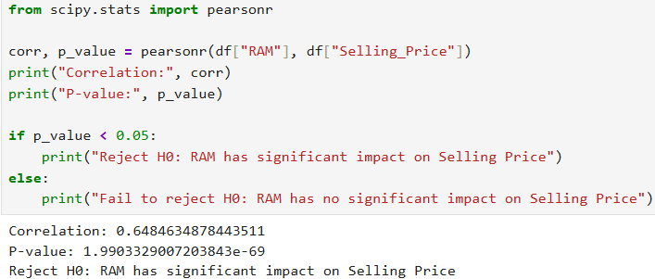
Hypothesis Test2: Does RAM affect laptop price?
H₀(Null Hypothesis): RAM has no impact on laptop price
H₁(Alternative Hypothesis): RAM affects laptop price
Test Used: Pearson Correlation Test
Decision Rule :
If p < 0.05 → Reject H₀
If p ≥ 0.05 → Fail to reject H₀
Result :
Correlation: 0.6484634878443511
P-value: 1.9903329007203843e-69
Since p < 0.05 → Reject H₀

Slide 21
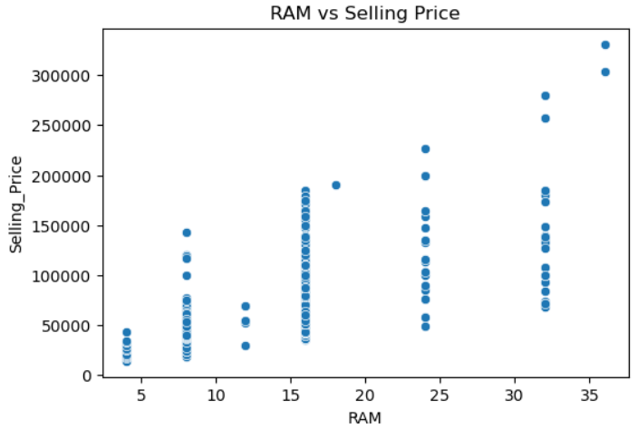
Insight:
There is a positive relationship between RAM and laptop price → As RAM capacity increases, the selling price generally increases.
This indicates that laptops with higher RAM configurations tend to be priced higher, as they offer better performance and higher specifications.

Slide 22
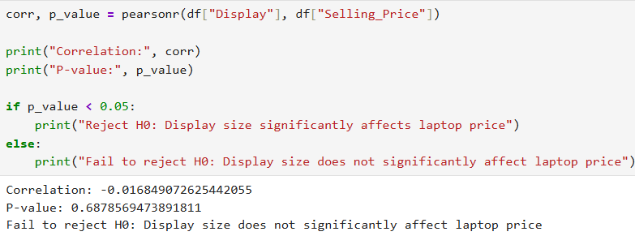
Hypothesis Test3: Display Size vs Selling Price
H₀(Null Hypothesis): Display size does not affect laptop price
H₁(Alternative Hypothesis): Display size affects laptop price
Test Used: Pearson Correlation Test
Decision Rule :
If p < 0.05 → Reject H₀
If p ≥ 0.05 → Fail to reject H₀
Result :
Correlation: -0.016849072625442055
P-value:0.6878569473891811
Since p > 0.05 → Failed to Reject H₀

Slide 23
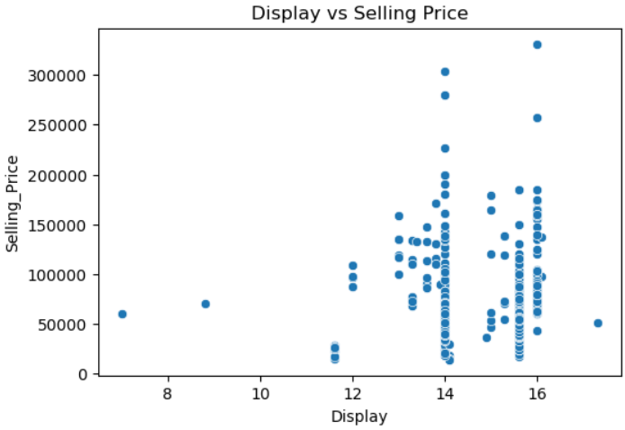
Insight:
There is no clear relationship between display size and laptop price.
Laptops with similar display sizes (around 14–16 inches) appear across a wide range of prices, indicating that display size does not significantly influence laptop pricing.

Slide 24
Challenges
Extracting structured information from unstructured laptop specifications
Cleaning Price Columns – Price values contained commas and text formats, so they had to be cleaned and converted to numbers.
Handling Missing Values – Some columns like SSD, Display, and Rating had missing values that needed proper treatment.
Handling Price Outliers – Premium and gaming laptops had very high prices which affected price distribution.
Selecting appropriate statistical tests for hypothesis analysis
Analyzing Relationships Between Features – Multiple visualizations were needed to understand how laptop specifications affect price.

Slide 25
Key Insights
Most Laptops Fall In The Mid-Price Range making it the most competitive market category.
Windows Is The Most Common Operating System, showing its strong dominance in the market.
8GB And 16GB RAM Laptops Are Most Popular
Processor Type Strongly Influences Price – Laptops with higher-end processors like Intel i7 / Ryzen 7 generally have higher prices.
Premium And Gaming Laptops Create Price Outliers
Discounts Vary Across Laptop Models – Different brands and configurations offer different discount levels in the market.
Ratings Are Mostly Positive Across Products
Laptop Specifications Directly Affect Price: Features like RAM, SSD capacity, and processor performance are key factors influencing laptop pricing.

Slide 26
Recommendations
Focus On Mid-Range Laptops – Laptops with 8GB–16GB RAM and SSD storage are widely preferred by customers.
Offer Competitive Pricing For Popular Configurations – Models with Intel i5 / Ryzen 5 and 8–16GB RAM should have balanced pricing.
Clearly Display Key Specifications – RAM, SSD, Processor, OS, and Display details should be shown clearly for easy comparison.
Increase Discounts Strategically – Proper discount offers can increase product visibility and attract more buyers.
Highlight High-Demand Features – Laptops with better processors, larger SSD storage, and higher RAM attract more customers.

Slide 27
Conclusion
Laptop price is mainly influenced by hardware specifications such as RAM, processor type, and SSD storage.
Mid-range laptops dominate the market, especially models with 8GB–16GB RAM and SSD storage.
Brand reputation also affects pricing, with well-known brands often having higher prices.
Premium and gaming laptops create price outliers due to higher performance specifications.
Display size has little impact on laptop price, as laptops with similar screen sizes appear across different price ranges.
Overall, laptop pricing is driven more by performance specifications than by display size.

Slide 28
Q & A

Slide 29

THANK YOU

